Slide 1
Networks and Operating Systems (252-0062-00)‏ Chapter 1: Introduction to Operating Systems
Adrian Perrig & Torsten Hoefler

Slide 2
Administrivia
Two parts:
Networks – Adrian Perrig
Operating Systems – Torsten Hoefler
Lecture:
Thu 8-10am, CAB G61
Fri 10am-noon, CAB G61
Practice sessions (subset of the ones in eDoz!):
Thu 3-6pm, ML F 40
Fri 1-4pm, CHN G 22
Fri 1-4pm, CAB G 57
Go to one of these sessions!
And participate!
Well, and participate in the lecture as well ☺

Slide 3
More Administrivia
Course webpage (the authoritative information source)
http://spcl.inf.ethz.ch/Teaching/2014-osnet/
All slides will be there before the lecture (so you can take notes)
Exercises are:
Theoretical: Analysis of performance properties
Practical: Trying out stuff + Programming exercises
We assume you know both C and Java.
Exercises start today!
There is a mailing list for questions to the Tas
You are not subscribed but can sign up at (if you want)
https://spcl.inf.ethz.ch/cgi-bin/mailman/listinfo/2014-osnet-ta
Please register during the break
put your name into lists at front desk of lecture hall

Slide 4
Exam
(No mid-term.)
Final exam: tbd (Session)
Material:
Covered in the lectures, and/or
Learned during the lab exercises
We will not follow the books closely.
All pieces will be in books though
Optional extra readings may appear on the web

Slide 5
Course Outline
20.02.: OS Introduction
21.02.: Processes
27.02.: Scheduling
28.02.: Synchronization
06.03.: Network Intro / OSI Model
07.03.: Physical Layer
13.03.: Memory Management
14.03.: Demand Paging
20.03.: skip
21.03.: Data Link Layer
27./28.03.: Network Layer
03./04.04.: Reliable Data Transfer
10.04.: File System Abstractions
11.04.: File System Implementations
17.04.: Naming, Name Resolution
02.05.: Network Programming
08./09.05.: I/O Subsystem
15.05.: Virtual Machine Monitors
16.06.: Reliable Storage, Specials
22.05.: Applications
23.05.: Security
30.05.: New Internet Architectures

Slide 6
Birds-eye perspective
Networks
bridge space
Databases
bridge time
Networks, Operating Systems, Databases
they all manage resources
OS, DB: all resources (storage, computation, communication)
Networks: focus on communication

Slide 7
Today: We start on Operating Systems!
Introduction: Why?
Roles of the OS
Referee
Illusionist
Glue
Structure of an OS

Slide 8
Goals
Demystify operating systems themselves
What is an OS? What does it do?
What is its structure?
How do the OS and applications relate to each other?
What services does the OS provide?
Quintessential “systems” problem
Non-idealizable / non-reducible
Scaling, emergent properties
Concurrency and asynchrony

Slide 9
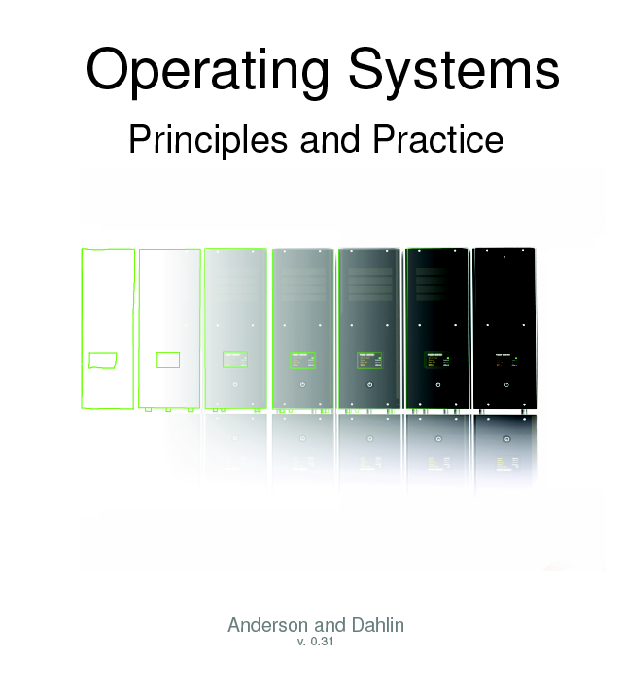
The Book
On the web:
http://ospp.cs.washington.edu/

Slide 10
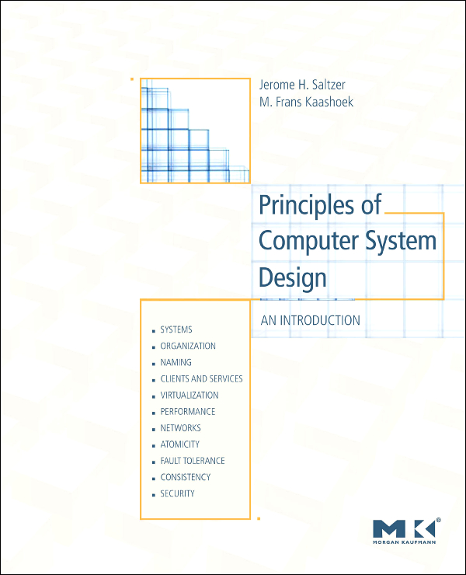
Also worth a look
Jerome H. Saltzer and M. Frans Kaashoek: “Principles of Computer System Design”
Focus on principles, with illustrative examples

Slide 11
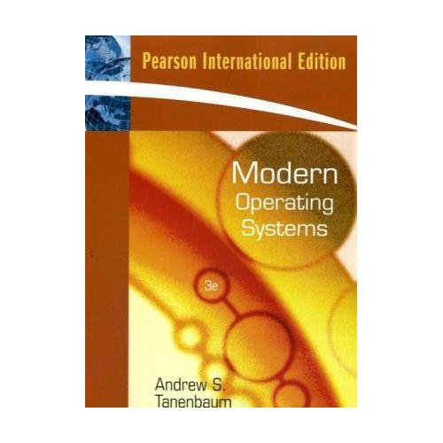
Also worth a look
Andrew S. Tanebaum: “Modern Operating Systems”
Must be at least 3rd Edition!
Very broad – lots of references to recent (2006) research.

Slide 12
Introduction to Operating Systems

Slide 13
Why learn about Operating Systems?
One of the most complex topics in Computer Science!
Very few simplifying assumptions
Dealing with the real world
Intersection of many areas
Mainstream OSes are large:
Windows 7 ~ 50 million lines of code
Linux rapidly catching up in complexity
Most other software systems are a subset
Games, browsers, databases, servers, cloud, etc.

Slide 14
Why learn about Operating Systems?
One of the most complex topics in Computer Science!
Very few simplifying assumptions
Dealing with the real world
Intersection of many areas
Mainstream OSes are large:
Windows 7 ~ 50 million lines of code
Linux rapidly catching up in complexity (~15 million LOC)
Most other software systems are a subset
Games, browsers, databases, servers, cloud, etc.

Slide 15
Why learn about Operating Systems?
One of the most complex topics in Computer Science!
Very few simplifying assumptions
Dealing with the real world
Intersection of many areas
Mainstream OSes are large:
Windows 7 ~ 50 million lines of code
Linux rapidly catching up in complexity (~15 million LOC)
Most other software systems are a subset
Games, browsers, databases, servers, cloud, etc.

Slide 16
There are lots of operating systems concepts…
Systems calls
Concurrency and asynchrony
Processes and threads
Security, authorization, protection
Memory, virtual memory, and paging
Files and file systems, data management
I/O: Devices, Interrupts, DMA
Network interfaces and protocol stacks

Slide 17

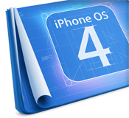






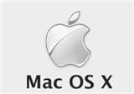




There are lots of operating systems…

Slide 18
Goals: what makes a good OS?

Slide 19
Goals: what makes a good OS?
Reliability: does it keep working?
And availability

Slide 20
Goals: what makes a good OS?
Reliability: does it keep working?
And availability
Security: can it be compromised?
And isolation: is it fair?

Slide 21
Goals: what makes a good OS?
Reliability: does it keep working?
And availability
Security: can it be compromised?
And isolation: is it fair?
Portability: how easily can it be retargeted?

Slide 22
Goals: what makes a good OS?
Reliability: does it keep working?
And availability
Security: can it be compromised?
And isolation: is it fair?
Portability: how easily can it be retargeted?
Performance: how fast/cheap/hungry is it?

Slide 23
Goals: what makes a good OS?
Reliability: does it keep working?
And availability
Security: can it be compromised?
And isolation: is it fair?
Portability: how easily can it be retargeted?
Performance: how fast/cheap/hungry is it?
Adoption: will people use it?

Slide 24
Operating Systems
Applications
Operating System
Hardware

Slide 25
Operating Systems
Applications
Operating System
Operating Systems (rest of this course!)
Hardware

Slide 26
Operating Systems
Applications
Parallel Programming
Operating System
Operating Systems (rest of this course!)
Hardware

Slide 27
Operating Systems
Applications
Parallel Programming
Operating System
Operating Systems (rest of this course!)
Computer Architecture and Systems Programming
Hardware

Slide 28
Operating System Roles

Slide 29
OS roles
Referee
Illusionist
Glue

Slide 30
The Referee:
Resource Manager
Application
Application
Application
System calls
Operating System
Hardware

Slide 31
The OS as Referee
Sharing:
Multiplex hardware among applications
CPU, memory, devices
Applications shouldn’t need to be aware of each other
Protection:
Ensure one application can’t r/w another’s data
In memory, on disk, over network
Ensure one application can’t use another’s resources
CPU, storage space, bandwidth, …
Communication:
Protected applications must still communicate

Slide 32
The OS as Referee
Sharing:
Multiplex hardware among applications
CPU, memory, devices
Applications shouldn’t need to be aware of each other
Protection:
Ensure one application can’t r/w another’s data
In memory, on disk, over network
Ensure one application can’t use another’s resources
CPU, storage space, bandwidth, …
Communication:
Protected applications must still communicate

Slide 33
The OS as Referee
Sharing:
Multiplex hardware among applications
CPU, memory, devices
Applications shouldn’t need to be aware of each other
Protection:
Ensure one application can’t r/w another’s data
In memory, on disk, over network
Ensure one application can’t use another’s resources
CPU, storage space, bandwidth, …
Communication:
Protected applications must still communicate

Slide 34
Resource management goals
Fairness:
No starvation, every application makes progress
Efficiency:
Best use of complete machine resources
Minimize e.g. power consumption
Predictability:
Guarantee real-time performance

Slide 35
Resource management goals
Fairness:
No starvation, every application makes progress
Efficiency:
Best use of complete machine resources
Minimize e.g. power consumption
Predictability:
Guarantee real-time performance
All in mutual contradiction
☹

Slide 36
Example: Threads
Threads are virtual CPUs
Physical resource: CPUs
Virtual resource: Threads
Mechanism: pre-emption, timeslicing, context switching, scheduling
More on this later in the course…

Slide 37
The Illusionist
Virtualization:
OS creates illusion of a “real” resource
Processor, storage, network, links, …
Virtual resource looks a bit like a physical resource
However, is frequently quite different…
Simpler, larger, better, …

Slide 38
How?
Multiplexing
Divide resources up among clients
Emulation
Create the illusion of a resource using software
Aggregation
Join multiple resources together to create a new one

Slide 39
Why?
Sharing
Enable multiple clients of a single resource
Sandboxing
Prevent a client from accessing other resources
Decoupling
Avoid tying a client to a particular instance of a resource
Abstraction
Make a resource easier to use

Slide 40
Example: Virtual Memory
Easier memory to manage
Physical resource: RAM
Virtual resource: Virtual Memory
Method: Multiplexing
Mechanism: virtual address translation

Slide 41
Example: Paged virtual memory
More memory than you really have
Physical resource: RAM and disk
Virtual resource: paged virtual memory
Method: multiplexing and emulation
Mechanism: virtual memory + paging to/from disk
Much more on this later in the course…

Slide 42
Example: virtual machines
Quite popular topic commercially right now:
Xen, VMware, HyperV, kvm, etc.
Many uses:
Run one OS on another
Consolidate servers
Migrate running machines around datacenter
Run hundreds of “honeypot” machines
Deterministic replay of whole machines
Etc.

Slide 43
Example: Files (or database!)
Virtual resource: persistant memory
Physical resource: disk
Method: multiplexing, emulation
Mechanism: block allocation, metadata
Again, more later…

Slide 44
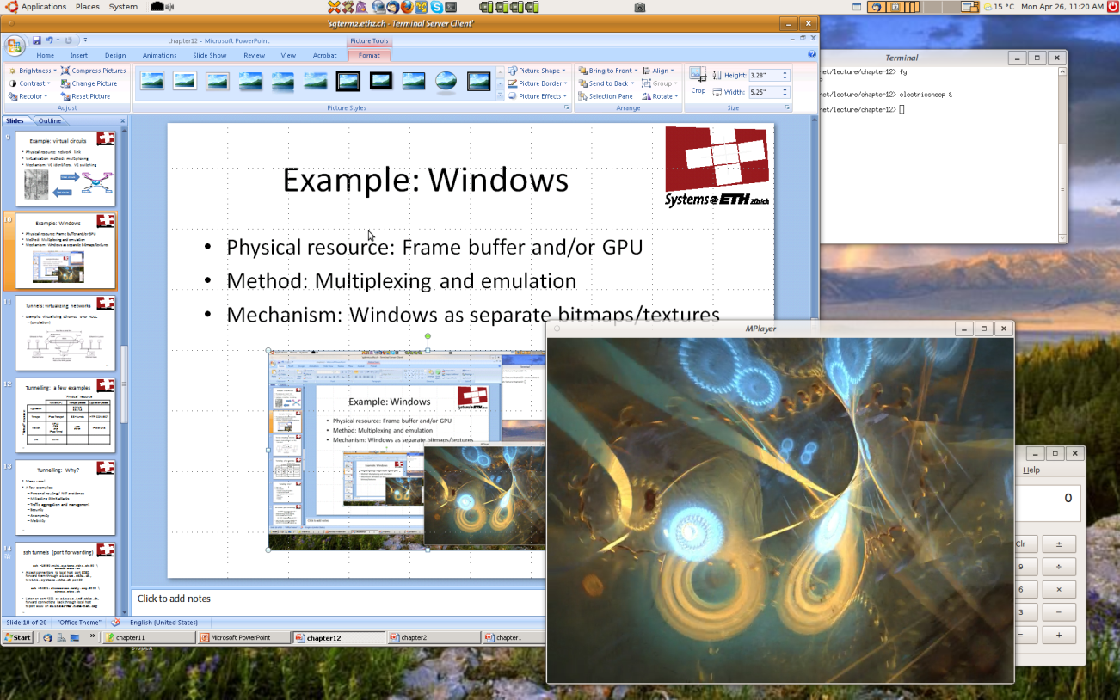
Example: Windows (not the Microsoft OS)
Physical resource: Frame buffer and/or GPU
Method: Multiplexing and emulation
Mechanism: Windows as separate bitmaps/textures

Slide 45
Example: virtual circuits
Physical resource: network link
Virtualization method: multiplexing
Mechanism: VC identifiers, VC switching
Virtual circuits
VCI=346
VCI=1044
1
4
2
3
Real circuits
VCI=1044
VCI=56

Slide 46
Example: VLANs
Methods: multiplexing
Mechanisms: port assignment, tags
A
B
C
D
I
M
J
S1
S2
S1
S2
N
K
N
E
G
H
F

Slide 47
Glue: the OS as Abstract Machine
Applications
Virtual machine interface
Operating System
Physical machine interface
Hardware

Slide 48
The OS as Glue
Provides high-level abstractions
Easier to program to
Shared functionality for all applications
Ties together disparate functions and services
Extends hardware with added functionality
Direct programming of hardware unnecessary
Hides details of hardware
Applications decoupled from particular devices

Slide 49
Services provided by an OS
Program execution
Load program, execute on 1 or more processors
Access to I/O devices
Disk, network, keyboard, screen,…
Protection and access control
For files, connections, etc.
Error detection and reporting
Trap handling, etc.
Accounting and auditing
Statistics, billing, forensics, etc.

Slide 50
Operating System Structure

Slide 51
General OS structure
Application
Application
Server process
(daemon)
System Library
System Library
System Library
System calls
User mode
Privileged mode
Kernel
CPU
CPU
Device
Device

Slide 52
Privileged Mode and User Mode
As we saw in Computer Architecture, most CPUs have a “privileged mode”:
ia32 protection rings
VAX kernel mode
Etc.
Most Operating Systems use this for protection
In particular, protecting the OS from applications!

Slide 53
General OS structure
Application
Application
Server process
(daemon)
System Library
System Library
System Library
System calls
User mode
Privileged mode
Kernel
CPU
CPU
Device
Device

Slide 54
Kernel
That part of the OS which runs in privileged mode
Large part of Unix and Windows (except libraries)
Small part of L4, Barrelfish, etc. (microkernels)
Does not exist in some embedded systems
Also known as:
Nucleus, nub, supervisor, …

Slide 55
The kernel is a program!
Kernel is just a (special) computer program.
Typically an event-driven server.
Responds to multiple entry points:
System calls
Hardware interrupts
Program traps
May also include internal threads.

Slide 56
General OS structure
Application
Application
Server process
(daemon)
System Library
System Library
System Library
System calls
User mode
Privileged mode
Kernel
CPU
CPU
Device
Device

Slide 57
System Libraries
Convenience functions
strcmp(), etc.
Common functionality
System call wrappers
Create and execute system calls from high-level languages
See ‘man syscalls’ on Linux

Slide 58
General OS structure
Application
Application
Server process
(daemon)
System Library
System Library
System Library
System calls
User mode
Privileged mode
Kernel
CPU
CPU
Device
Device

Slide 59
Daemons
Processes which are part of the OS
Microkernels: most of the OS
Linux: increasingly large quantity
Advantages:
Modularity, fault tolerance
Easier to schedule…

Slide 60
Entering and exiting the kernel

Slide 61
When is the kernel entered?
Startup
Exception: caused by user program
Interrupt: caused by “something else”
System calls

Slide 62
Recall: System Calls
RPC to the kernel
Kernel is a series of syscall event handlers
Mechanism is hardware-dependent
User mode
Privileged mode
System calls

Slide 63
Recall: System Calls
RPC to the kernel
Kernel is a series of syscall event handlers
Mechanism is hardware-dependent
User process runs
User mode
Privileged mode
System calls

Slide 64
Recall: System Calls
RPC to the kernel
Kernel is a series of syscall event handlers
Mechanism is hardware-dependent
User process runs
Execute syscall
User mode
Privileged mode
System calls

Slide 65
Recall: System Calls
RPC to the kernel
Kernel is a series of syscall event handlers
Mechanism is hardware-dependent
User process runs
Execute syscall
User mode
Privileged mode
System calls

Slide 66
Recall: System Calls
RPC to the kernel
Kernel is a series of syscall event handlers
Mechanism is hardware-dependent
User process runs
Execute syscall
User mode
Privileged mode
Execute kernel code
System calls

Slide 67
Recall: System Calls
RPC to the kernel
Kernel is a series of syscall event handlers
Mechanism is hardware-dependent
User process runs
Execute syscall
Process resumes
User mode
Privileged mode
Execute kernel code
System calls

Slide 68
System call arguments
Syscalls are the way a program requests services from the OS kernel.
Implementation varies:
Passed in processor registers
Stored in memory (address in register)
Pushed on the stack
System library (libc) wraps as a C function
Kernel code wraps handler as C call

Slide 69
When is the kernel exited?
Creating a new process
Including startup
Resuming a process after a trap
Exception, interrupt or system call
User-level upcall
Much like an interrupt, but to user-level
Switching to another process

